Slide 1
Hickory Ridge Proposal
September 5, 2019

Slide 2
Property Aerial View - West
Amherst Town Boundary
West Pomeroy Ln
Fort River

Slide 3
Property Aerial View - East
Taylor Davis
Golf Course Outbuildings

Slide 4
Property Aerial View - North
Apartment Complexes (Southpoint, Mill Valley, The Boulders, The Brook)

Slide 5
Property Aerial View - Clubhouse
Shed
Clubhouse

Slide 6
Property – Clubhouse Detail

Slide 7
Property – Parking Detail

Slide 8
Property – Cart Path Detail

Slide 9
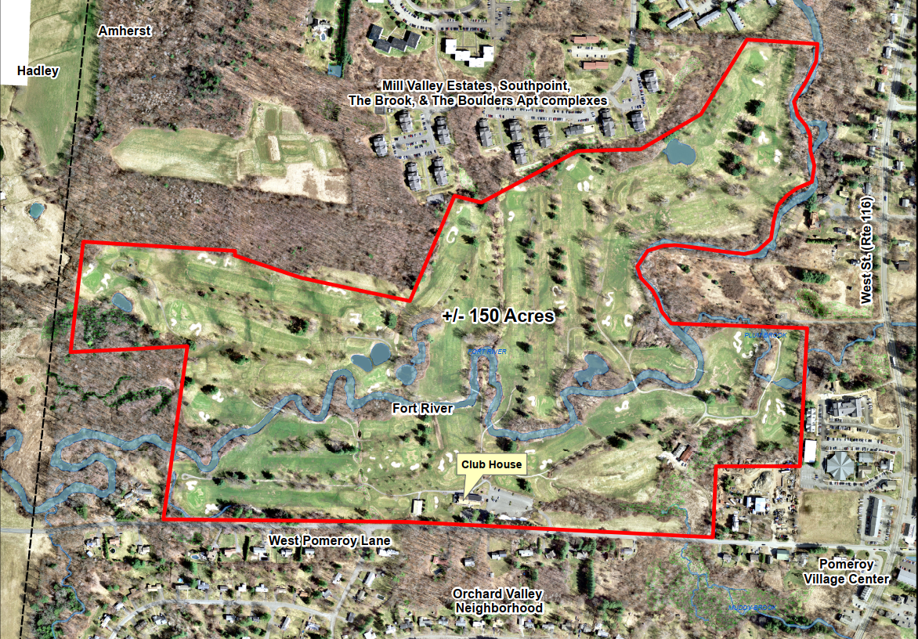
Map of Property

Slide 10
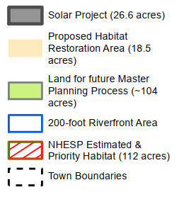
Map of Property

Slide 11
Purchase & Sale
P&S signed: August 7, 2019
Negotiated sale price: $520,000
Major Contingencies:
Town Council appropriation of funds to purchase
Seller accepted to Solar Massachusetts Renewable Target (SMART) Program in block sufficient to make sale economically feasible
Mutually agreeable easement agreement

Slide 12
Project Details
Town to purchase entire 149 acre parcel
Seller to retain easement of 26 acres for solar use
Requires habitat mitigation for state-listed rare & endangered species
Initial term of 20 years, plus four 5-year extensions
Town to conduct master planning process to assess compatible uses for remainder of property

Slide 13
Potential Uses
Conservation land (using CPA funds)
Trails connecting Southpoint, Boulders & Mill Valley to South Amherst Village Center
Reuse of clubhouse/outbuildings and buildable land
Senior Center
Affordable Housing
“Swing space” for Fire/DPW
Sale of private house lots

Slide 14
Financing: Bargain Sale
Appraised Value: $915,000
Negotiated Purchase & Sale Price: $520,000
Bargain Sale: $395,000 (43% lower than appraised value)

Slide 15
Financing: Funding Sources
Purchase Price: | $520,000
CPA Funding (appropriated): | $200,000
Existing Funds from the Sale of Real Estate : | $114,000
Funds Needed to Purchase: | $206,000
Additional Funds Required: | $100,000
Total Funds Requested for Appropriation: | $306,000
Additional funds necessary to cover costs of:
Insurance
Maintenance (mowing, trailheads, kiosks, etc.)
Utilities
Legal costs
Property survey
Environmental testing (21E)

Slide 16
Taxes & Solar PILOT
Tax Impact:
Property currently pays ~$30,000/year at a reduced tax rate because the majority of property is in Chapter 61B (recreation)
Estimated PILOTs (includes 2.5% annual escalator):
Year 1: $39,800
Year 20: $63,700

Slide 17
Thank You
QUESTIONS?

